Slide 1
Review of 2013 Mosquito Surveillance and Suppression Activities for Vermont Pesticides Advisory Council
March 26, 2014 Meeting
Alan C. Graham
Vermont Agency of Agriculture
Erica Berl
Vermont Department of Health

Slide 2
Overview
Review 2013 Year
Mosquito suppression activities
Plans for this year
Culiseta melanura studies
Cervid sero survey

Slide 3
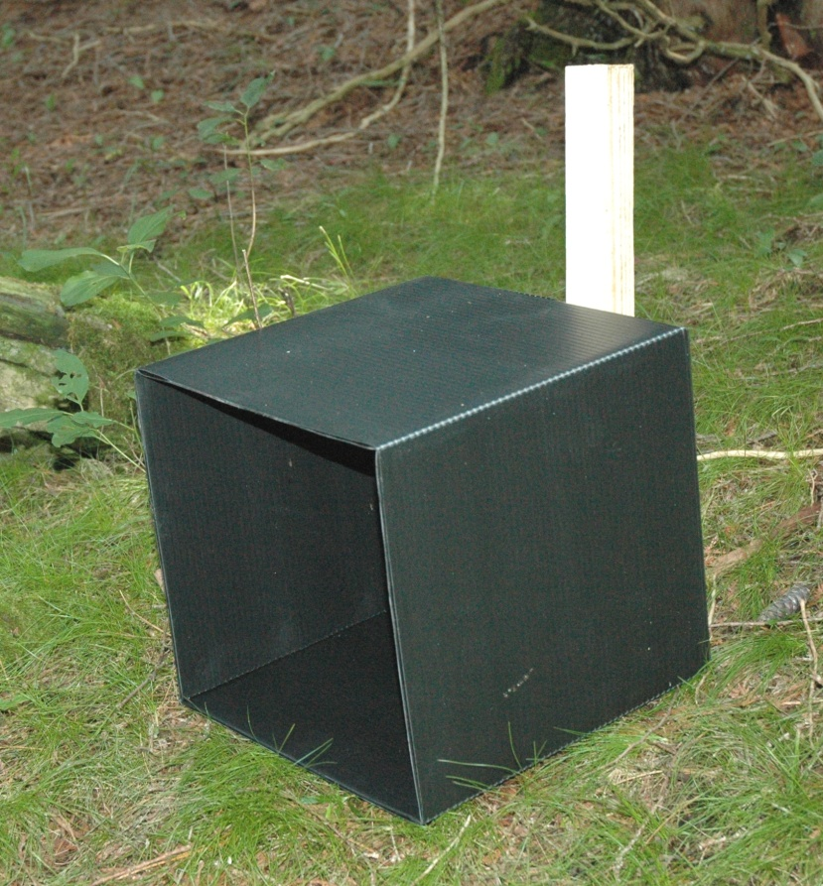
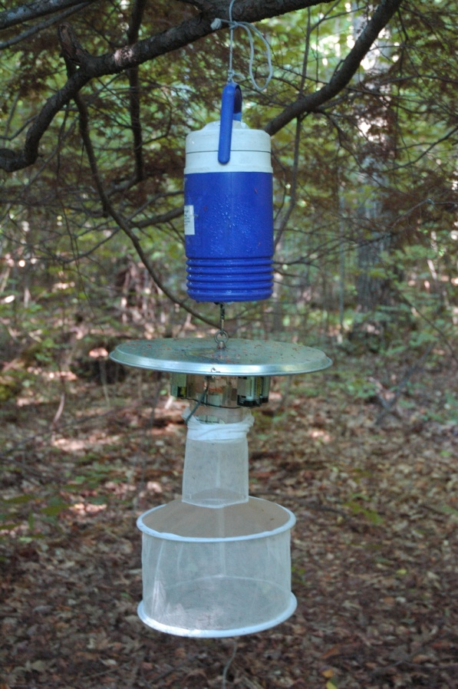
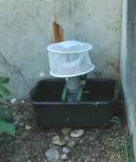
Three Types of Mosquito Traps
Resting Box Trap
CDC Light Trap
Gravid Trap

Slide 4
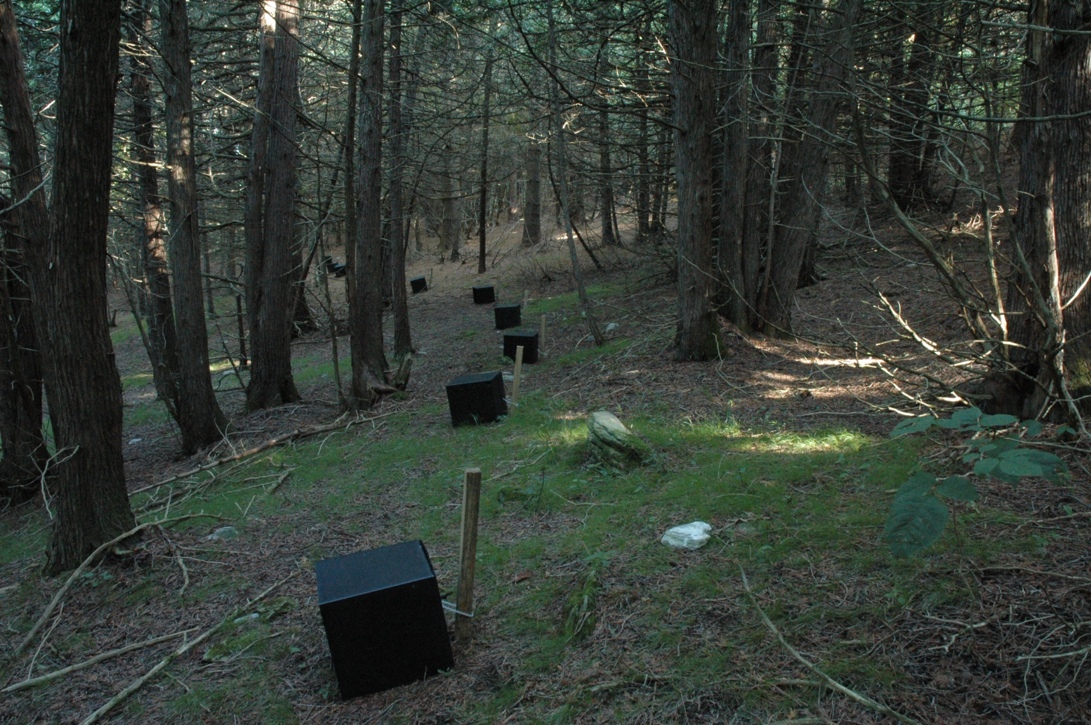
Typical Resting Box Trap Site

Slide 5
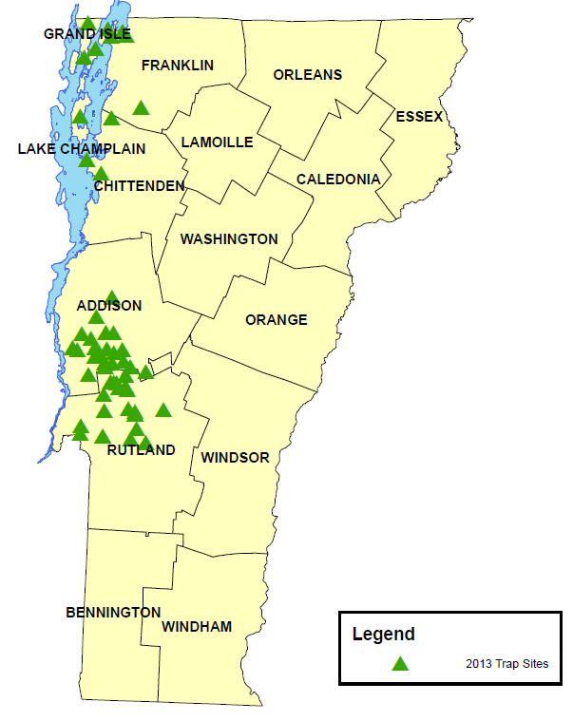

2013 Trap Locations
31 Resting Box Trap Sites
36 CDC Light Traps
3 Gravid Trap Sites

Slide 6
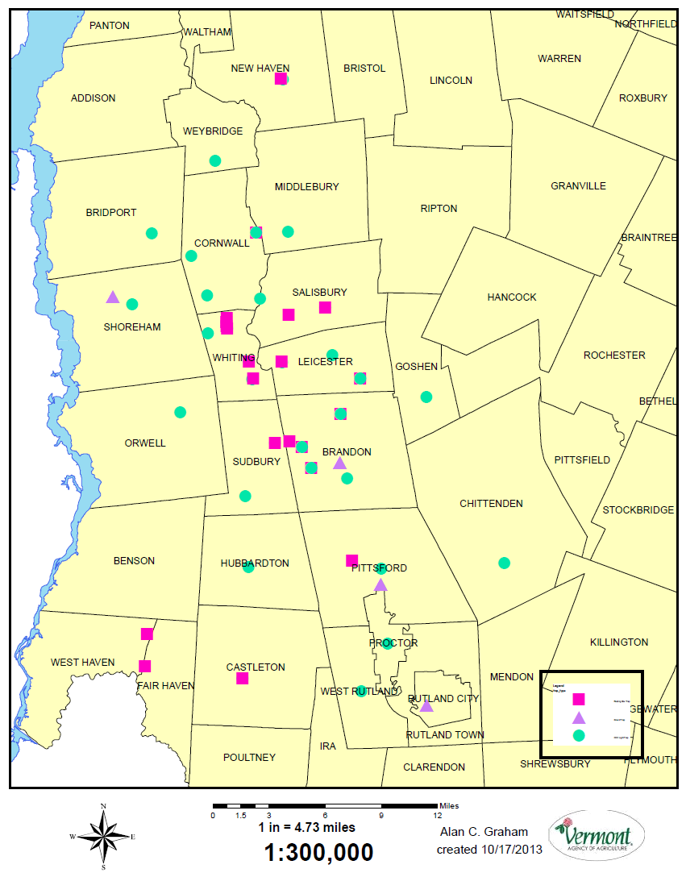
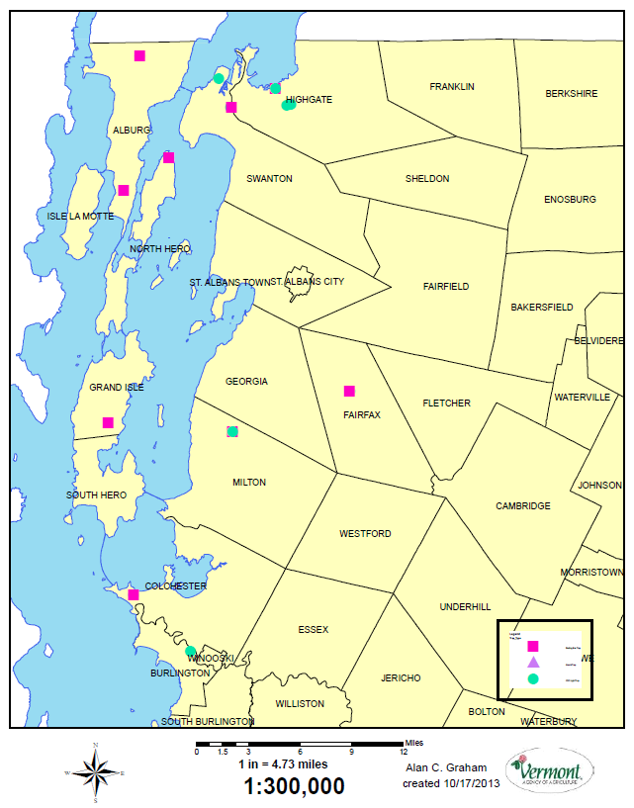
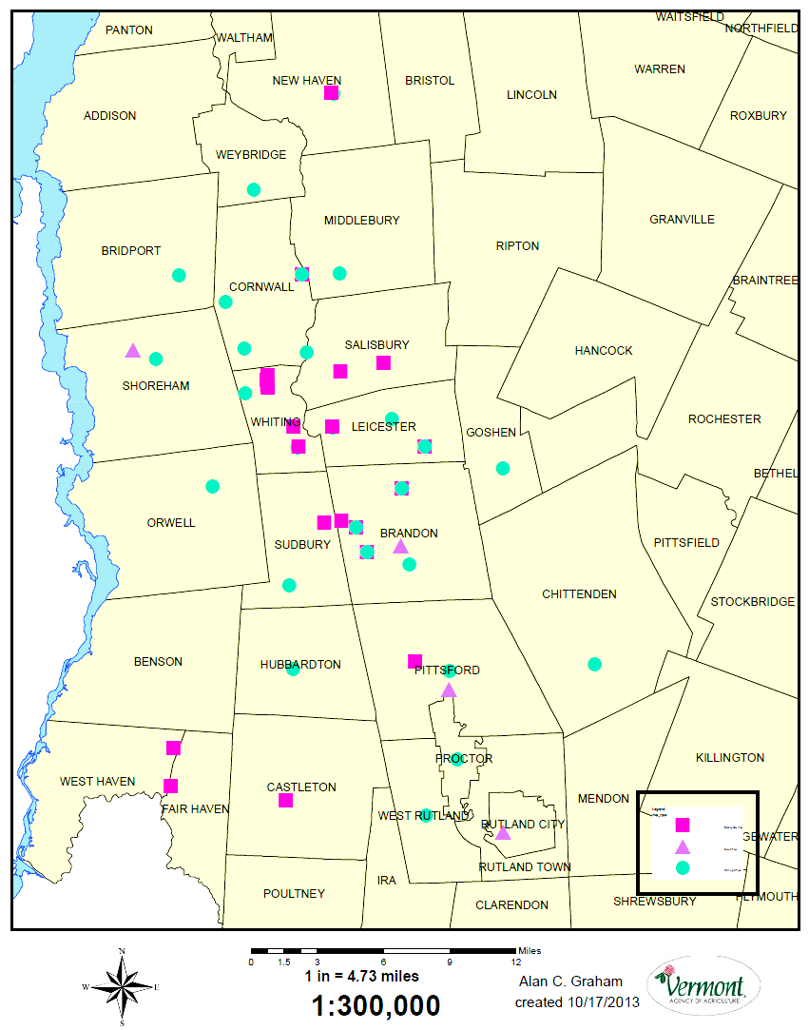
Mosquito Trap Locations
Resting box
Resting box
Gravid trap
CDC trap
CDC trap

Slide 7
Trapping Effort
32,727 mosquitos identified from 31 towns
Primary and Secondary Vector Species tested
1,338 mosquito pools tested
16,729 mosquitoes tested

Slide 8
2013 Temperature and Precipitation

Slide 9
Arbovirus Test Results
4,481 Culiseta melanura collected
22 EEE+ pools – 6 towns
  20 Cs melanura
  1 Cq perturbans
  1 mix of Cx pipiens/restuans
29 WNV+ pools – 12 towns
  18 Cs melanura
  10 Cx pipiens/restuans
  1 Aedes vexans

Slide 10
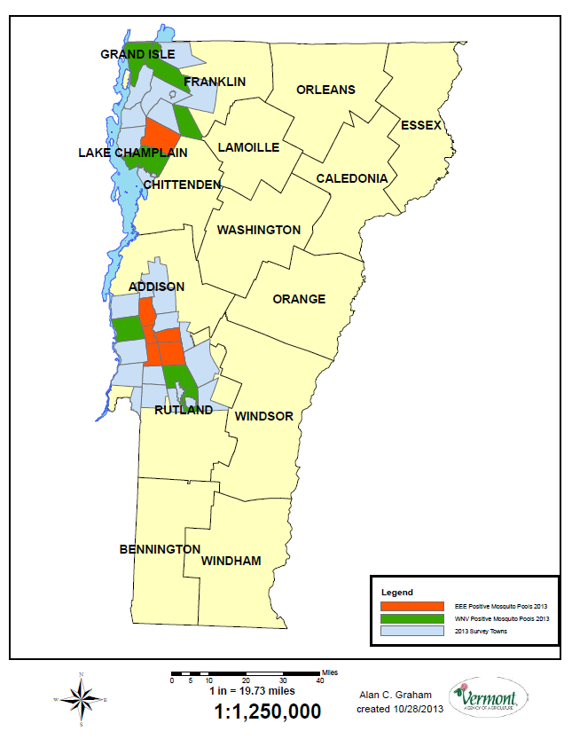
Map Summarizing 2013 Mosquito Surveillance Findings
Surveyed towns
WNV+ pools
EEE+ pools

Slide 11
2013 Arbovirus Phenology
Number of positive pools
Cx. r/p, Cs. melanura, Cq perturbans
Cx. r/p
Cs. melanura
Cs. morsitans
Ae. vexans, Cx. r/p, Cs. melanura
Cx. r/p, Cs. melanura
Cs. melanura
Cs. melanura
June
July
August
Sept
Oct
First positive
case:
Last positive
case:
EEE: 08/01/13
WNV: 07/10/13
EEE: 09/12/13
WNV: 10/08/13

Slide 12
No Human Cases of EEE
Found in 2013

Slide 13
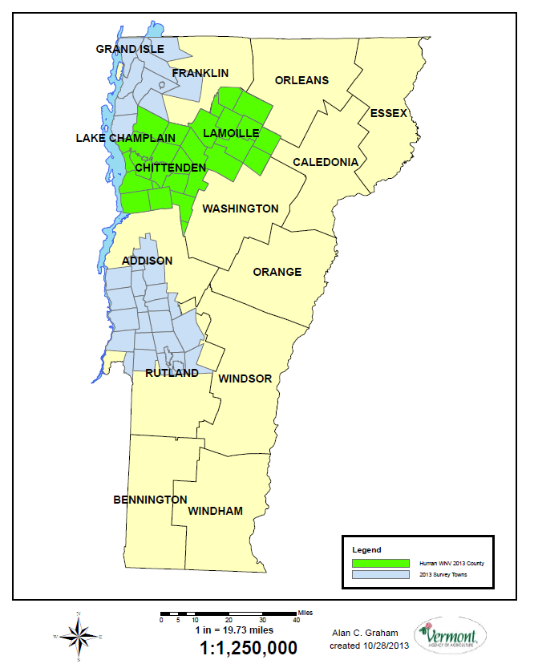
2 Human Cases of WNV in 2013
1 Chittenden Co.
1 Lamoille Co.
Surveyed counties
WNV+ humans

Slide 14
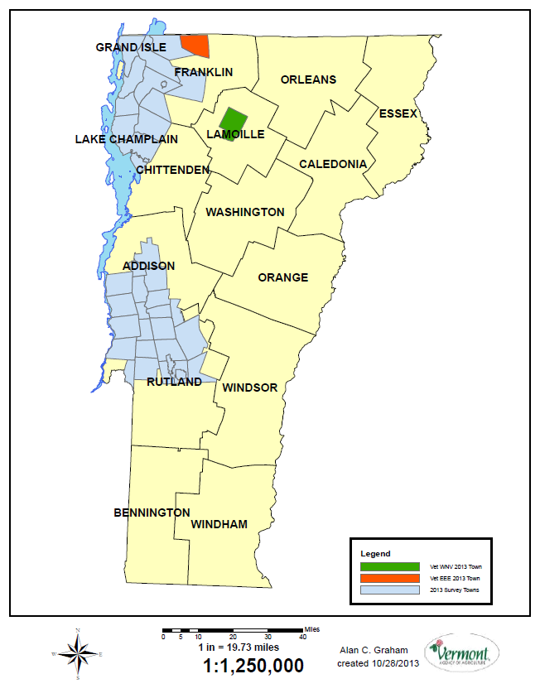
2013 Veterinarian Arbovirus Reports
2 EEE+ horses in Highgate
1 WNV+ horse in Johnson
Vet WNV+ cases
Vet EEE+ cases
Surveyed towns
* All cases were reported in August

Slide 15
Concerns During Season
Sustained EEEv positive mosquitoes findings at single site in Whiting
Continued high population of primary vector species
Potential for increased virus amplification during season

Slide 16
Aerial Spray Operation
The decision to use mosquito adulticide made after “Declaration of Public Risk”
by Vermont Department of Health Commissioner
Notes:
Points: The decision to use mosquito adulticide was made after “declaration of public risk” by Vermont Department of Health Commissioner

Slide 17
Response to EEE in 2013
Mosquito control
Mosquito Control Districts
  Small MCDs in southern Addison/northern Rutland Counties – goal is to reduce nuisance mosquitoes
    Larviciding
    Adulticiding – from trucks
Aerial application of adulticide by State
  2 mile square around wetland in Whiting
  Not part of MCD, too few roads for truck-based spraying
  Pre-spray and post-spray monitoring
Notes:
At the time the decision was made to treat around the Whiting swamp, no positive mosquito pools had been detected anywhere else. But by the time the spray occurred, positive pools were detected outside of the spray zone.

Slide 18
Recommendations
Experts from CDC and Massachusetts
Do 2 adulticide treatments
  At night
  5 days apart
  Product – Anvil 10-10

Slide 19

Adulticide Operation
Dynamic Aviation from Bridgewater, VA
Swath: 1,000.0 feet
Average Plane Speed: 178.0 MPH
Product: Anvil 10+10 (10% Sumithrin and 10% Piperonyl butoxide)
Rate: 0.62 Oz/acre
Sprayed Area: 7,400 acres
Excluded Area: 400 acres
8/22 and 8/27

Slide 20
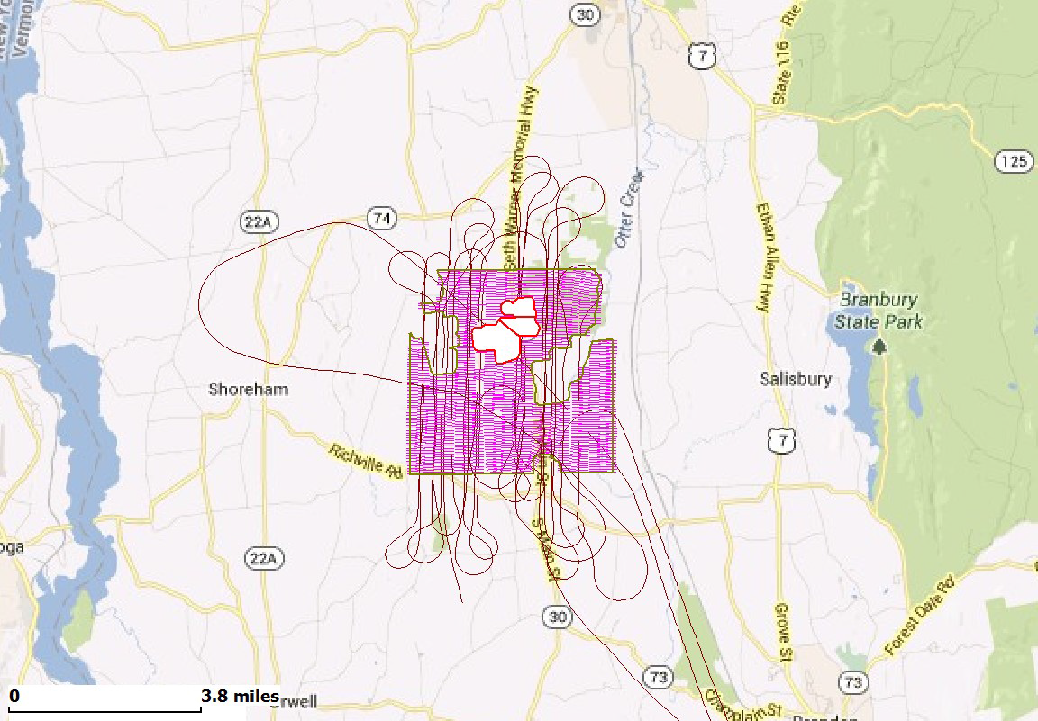

Treatment Map
Burlington
(Approx. 39.5 miles)
Montpelier
(Approx. 40.5 miles)

Slide 21
Efficacy Results
Compare pre treatment mosquitoes with post treatment mosquito counts
Trap within treatment area and outside treatment area
Compare numbers
Cq perturbans used because present in all areas
Treatment was 79.7% to 96.8% effective

Slide 22
When is Larvicide Used?
Survey for mosquito larvae in 1st and 2nd instars 36 to 48 hours after flood event
Identify wetlands with dipper counts >25 larvae/ dip
Sample for each 200 acres of wetland
Target known pest floodplain species
  Ae vexans, Oc trivittatus, Ae cinereus
Treatment while larvae in early instar

Slide 23
Why?
Source reduction of mosquitoes best
Targeted pesticides for mosquito larvae
Safest approach to mosquito management
Reduce need for adulticide spraying

Slide 24
2013 Larvicide Treatments
928
576
Rain
Events
Total acreage treated (Vermont)
360
352
248
208
05/27
05/28
05/30
06/30
07/03
07/25
Treatment Date
Notes:
Points: Larviciding is used to control nuisance mosquitoes, Aedes vexans and Ochlerotatus trivittatus.

Slide 25
Goals for 2014
Increase mosquito surveillance
Improve timeliness of mosquito testing
Continue to improve communication between state and local officials and between officials and the general public
Update the response plan
GOAL: prevent human and animal illness

Slide 26
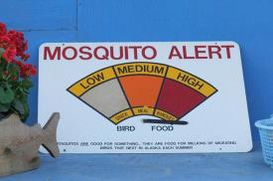
Communication Tool -Risk Assessment Matrix
Risk and response based indicators of virus activity
  Previous years’ activity
  Current year mosquito surveillance
  Human or other mammalian cases
But
Risk assessment is not straightforward
  Lack of data presents a challenge
  Many variables affect risk
No matter what we do, no way to guarantee that we can prevent all illness.

Slide 27
Risk Assessment Maps - 2013
Addison and Rutland Counties

Slide 28
Actions in Response to Risk Levels
Risk Level | State Response | Local Response | Personal Response
Baseline | General education messages disseminated statewide | Assist with dissemination of information | Prevent mosquito bites; reduce standing water on property
Low | Targeted educational messages to affected communities; consider additional mosquito surveillance | Local MCD may increase larviciding and/or adulticiding | As above
Moderate | Consider recommending larviciding; Consider targeted adulticiding | Consider targeted adulticiding | Limit time outdoors when mosquitoes are active
High | Consider more widespread adulticiding | Consider cancelling organized outdoor evening activities | Consider avoiding outdoor evening activities

Slide 29
Response to EEE detection in 2014 – Education and Outreach
Educational messages –
  Avoid mosquito bites
  May recommend avoiding outdoor activity from dusk to dawn
Communication avenues
  Media – print, radio, TV
  Flyers - through town officials
  Website
  Phone: 211/toll-free hotline
  Phone calls to high-risk populations – schools, nursing homes
  Mailings, door-to-door, email, Facebook?
Maximize local and state collaboration

Slide 30
2014 Surveillance Plans
Continue to focus on Cs melanura habits
Enhanced surveillance in areas where EEEv has been found
  Rutland and Addison Counties
  Northwest Loop – Franklin County
Expand into Windsor County
Culex trapping near population centers

Slide 31
What do we know about Culiseta melanura?

Slide 32
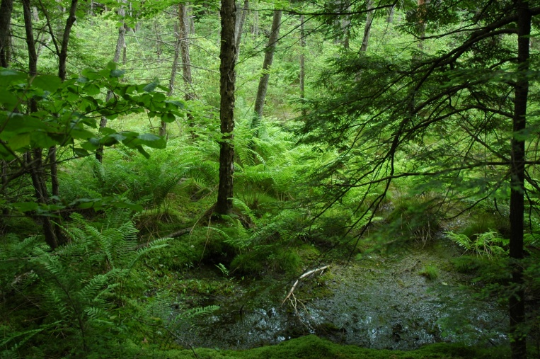
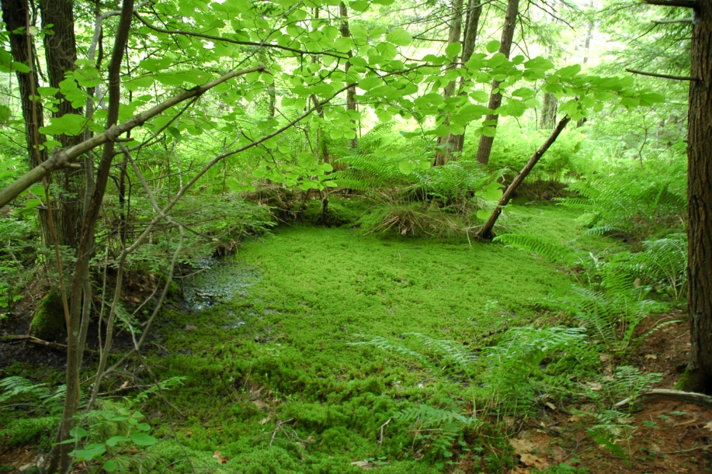
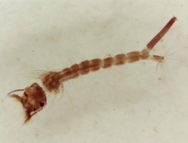
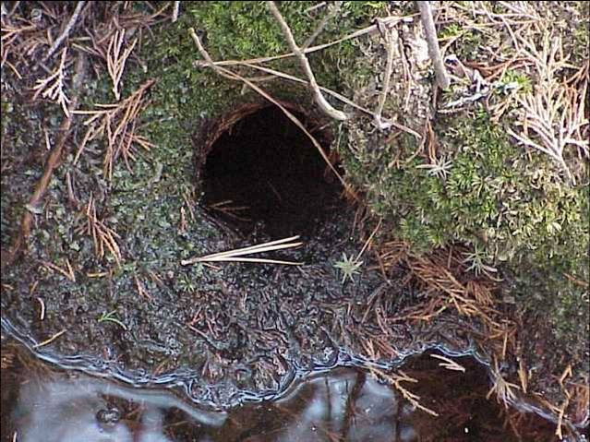
Culiseta melanura is Primary Vector
Prefers acidic hardwood swamps
Larvae found in holes under root masses

Slide 33
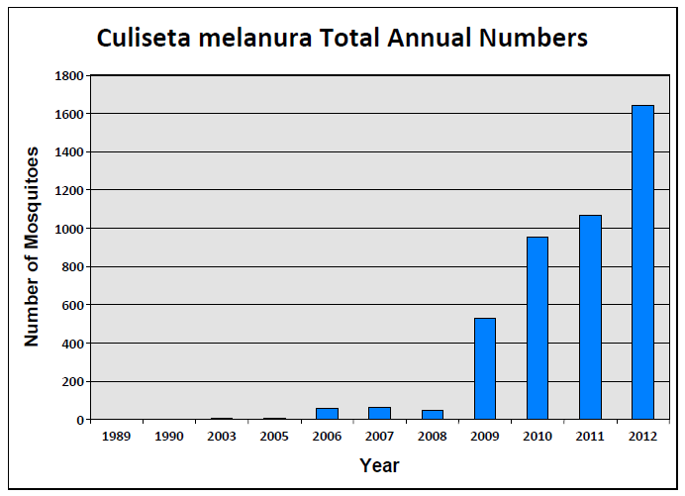
Focused Trapping for
Culiseta melanura in Vermont
In 2013 we trapped 4581 Culiseta melanura

Slide 34
Weekly Average Culiseta melanura numbers at Whiting Site
July 1st

Slide 35
Host Feeding Preference Study
Blooded mosquitoes analyzed
Collected near 2012 EEE focus
Tested for arbovirus
Blood DNA analyzed to identify host

Slide 36
Host Feeding Patterns of Culiseta melanura in Vermont
308 Cs. melanura analyzed
52 host species identified
49 bird species
  Migratory and resident birds
  43 passerine birds
3 mammal species

Slide 37
What do we know about Culiseta melanura?
Mosquito feeds mostly on birds (94%)
May feed on mammals (6%)
  Cows (4.3%)
  Humans (1.2%)
  Deer (0.6%)

Slide 38
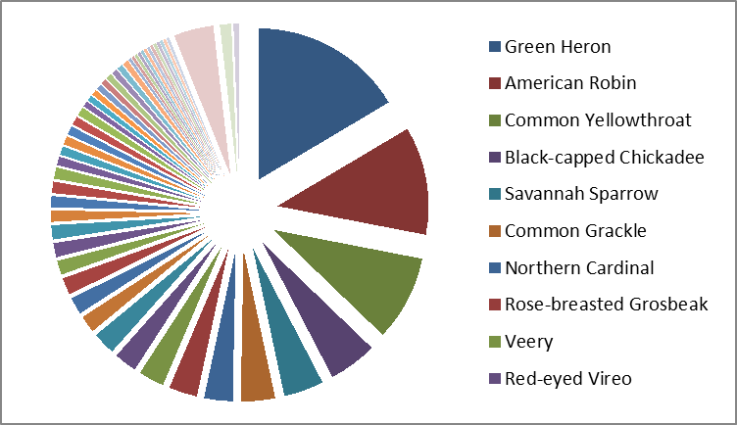
Pie Graph Listing
Top Ten Host Species
Mammals

Slide 39
Top Ten Bird Species as
Hosts for Culiseta melanura
65.6% of blood meals represented by 10 bird species (202/308)
  7 migratory
  3 resident
  9 passerine
Vertebrate Host | No.
Green Heron | 54
American Robin | 38
Common Yellowthroat | 30
Black-capped Chickadee | 17
Savannah Sparrow | 14
Common Grackle | 12
Northern Cardinal | 10
Rose-breasted Grosbeak | 10
Veery | 9
Red-eyed Vireo | 8

Slide 40
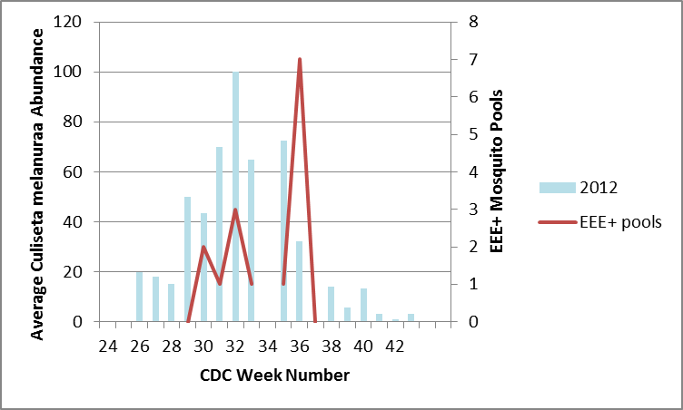
Average Number Cs melanura compared with EEE+ 2012 pools

Slide 41
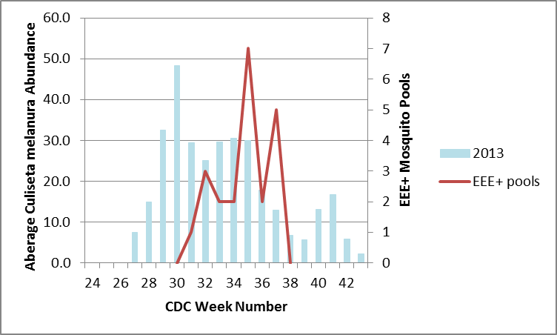
Average Number Cs melanura compared with EEE+ 2013 pools

Slide 42
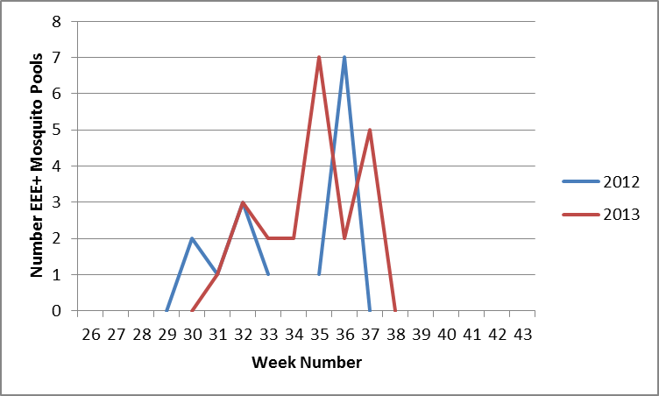
EEE+ Pools in 2012 and 2013
Late July thru Mid September
7/24
8/1
8/27
9/12

Slide 43
Vermont Cervid Sero Survey
2010-2012
Quick Review of What We Have Seen
Alan C. Graham, Vermont Agency of Agriculture
Erica Berl, Vermont Department of Health

Slide 44
Objective
The purpose of this project is to better understand the distribution of Eastern Equine Encephalitis (EEE) virus in Vermont by testing deer and moose blood for antibodies specific for this virus.

Slide 45
Underlying Assumptions
Deer are widespread in the state and are susceptible to infection with EEE virus
Deer can be a good sentinel of EEE virus activity in Vermont
Antibodies in deer are produced by the immune system and can be detected in the blood for several years following an infection
Since deer reside in a relatively small home range, the detection of an antibody-positive individual gives a fairly good indication of where the deer was infected.

Slide 46
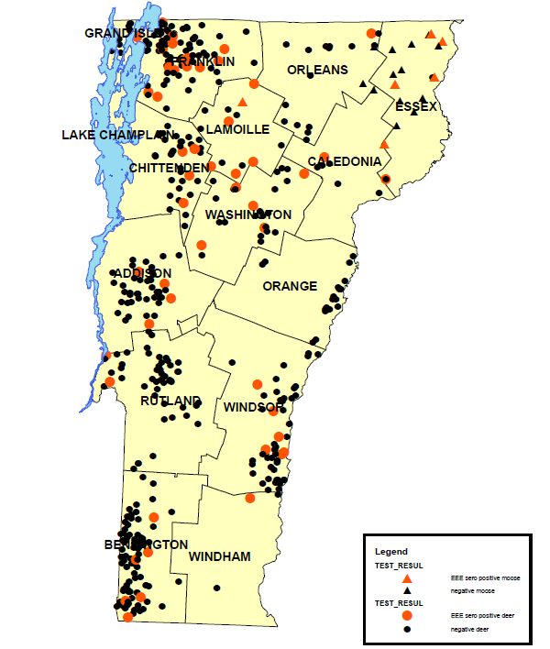
2010
Sero Survey
11.5% cervids seropositive for EEEv
504 deer and moose sero samples
52/483 seropositive deer = 10.8%
6/21 seropositive moose = 28.6%

Slide 47
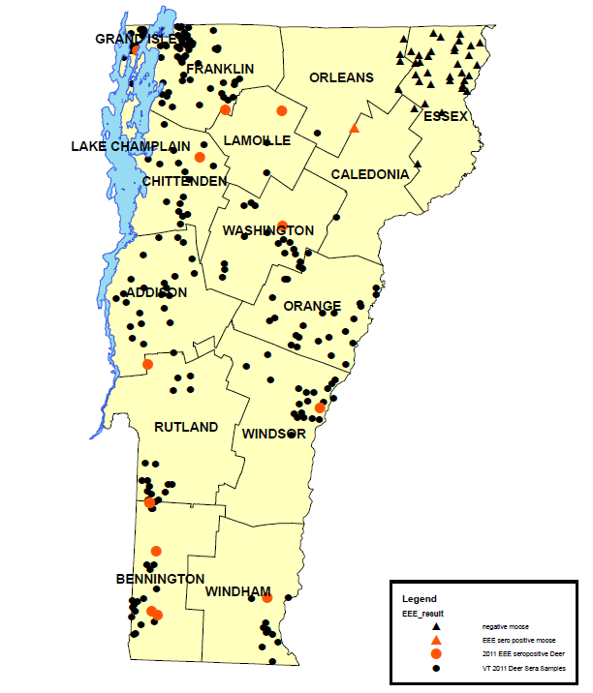
2011
Sero Survey
5.7% cervids seropositive for EEEv
228 deer and moose sero samples
12/189 seropositive deer = 6.3%
1/39 seropositive moose = 2.6%

Slide 48
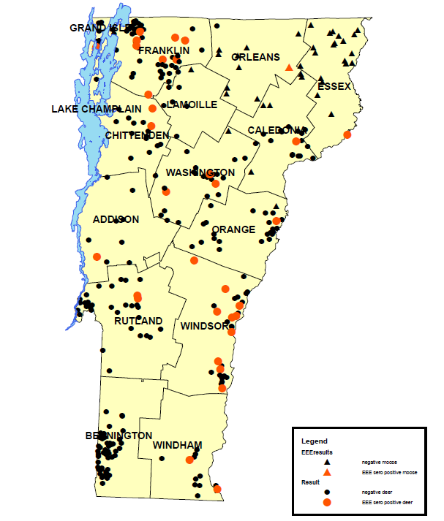
2012
Sero Survey
10.6% cervids seropositive for EEEv
330 deer and moose sero samples
34/288 seropositive deer = 11.8%
1/42 seropositive moose = 2.4%

Slide 49
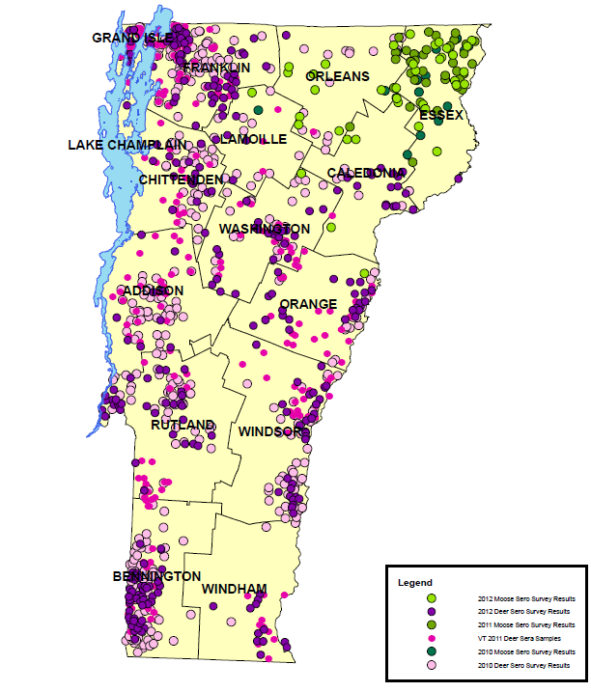
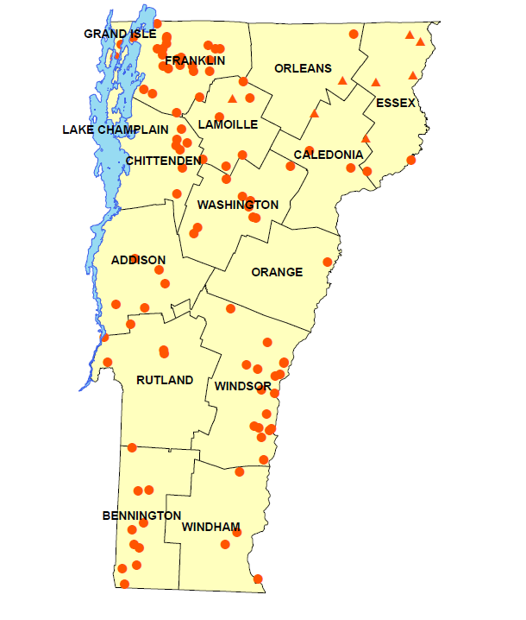
Summary 2010-2012
Cervids tested
EEEv Sero Positive Cervids

Slide 50
EEEv Sero Positive Cervids 2010-2012
10.0% cervids seropositive for EEEv
960 deer and moose sero samples
98 seropositive deer = 10.2%
8 seropositive moose = 7.8%

Slide 51
Unknown
Are deer in Vermont susceptible to EEEv virus?
How long do EEEv antibodies last in cervids?
Are antibodies acquired through milk and/or placenta?
Is Culiseta melanura the primary vector mosquito species throughout Vermont?

Slide 52
Other Antibodies We Found
Lyme disease
Anaplasmosis
Deer Tick Virus

Slide 53
2014 Tick Surveys
Quantitative Sampling (Alan Giese)
  Tick abundance
  Disease risk
Test for tick-borne diseases (AGR lab)
  Borrelia (Lyme disease)
  Anaplasmosis
  Babiosis

Slide 54
For More Information on Mosquito-Borne Viruses
  Vermont Agency of Agriculture
    http://agriculture.vermont.gov/plant_pest/mosquitoes_ticks/mosquitoes/testing
  Vermont Department of Health
    http://healthvermont.gov/prevent/arbovirus/surveillance/index.aspx
  Centers for Disease Control
    http://www.cdc.gov/EasternEquineEncephalitis/
    http://www.cdc.gov/westnile/index.html

Slide 55
Acknowledgements
This work would not have been possible
without collaboration among several agencies and volunteers
Vermont Agency of Agriculture
Vermont Department of Health
Centers for Disease Control
Connecticut Agricultural Experiment Station
New York State Wadsworth Lab
Vermont Fish and Wildlife Department
United States Department of Agriculture
and many Volunteers
Thanks to everyone

